Slide 1

AMAZON WEB SERVICES (Applied Data Science) Topic – EC2
Dr. Nilay Karade
Academic Program Manager

Slide 2
Quick recap
S3 bucket storage
Create a Bucket,
Upload Objects,
Download Objects,
Versioning,
Server-Side Encryption,
Lifecycle Policies
Command line interface
Installation
S3 related commands

Slide 3
Assignments
Create one dollar budget
Upload multiple csv file in a S3 bucket with single AWS CLI command
Read multiple csv from S3 bucket into Pandas Dataframe
Develop static website and host it on S3

Slide 4
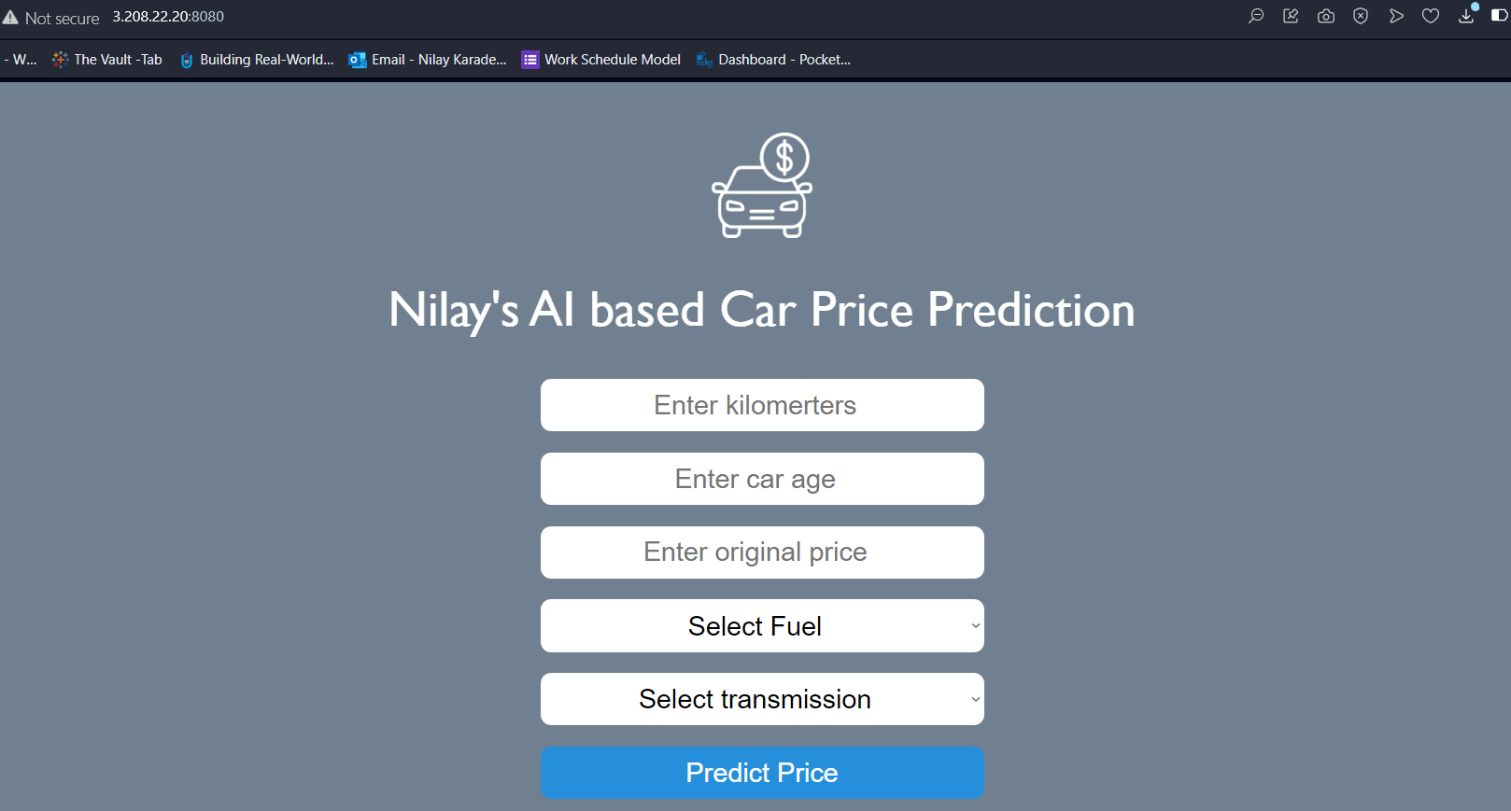
Agenda

Slide 5
Agenda
Virtual machine
Overview of web app
EC2 instance (Terminate your EC2 after successful deployment to avoid huge billing from AWS)
Deploy web app on EC2
Putty
WinSCP
Linux command

Slide 6
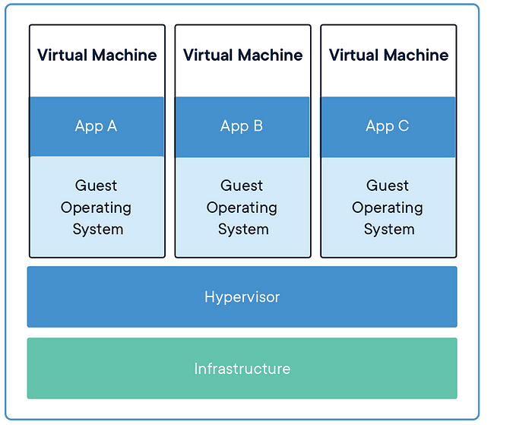

Server vs Virtual server
https://medium.com/@syed.sohaib/virtual-machines-in-azure-7efdee4df802

Slide 7
Elastic Compute Cloud (EC2)
Amazon Elastic Compute Cloud (Amazon EC2) is a web service provided by Amazon Web Services (AWS) that offers resizable compute capacity in the cloud.
EC2 allows you to quickly and easily provision virtual servers, known as instances, and scale your computing resources up or down as needed.
This provides the flexibility to run applications, host websites, process data, and perform a wide range of computing tasks without investing in physical hardware.

Slide 8
Key features and concepts of Amazon EC2 :
Instances: EC2 instances are virtual servers that you can launch in the cloud. Instances are available in various sizes and configurations, each optimized for specific workloads.
Instance Types: EC2 offers a variety of instance types optimized for different use cases, such as compute-optimized, memory-optimized, storage-optimized, and GPU instances.
AMI (Amazon Machine Image): An AMI is a pre-configured template used to create instances. It includes the operating system, software, and other settings. You can choose from existing AMIs or create your own.
Elastic Block Store (EBS): EBS provides persistent block storage that can be attached to EC2 instances. It allows you to store data independently of the instance and can be used for boot volumes or additional storage.

Slide 9
Setup EC2 instance
PuTTY
WinSCP/FileZila

Slide 10
Setup EC2 instance – PuTTY setup
PuTTY is a free and open-source terminal emulator, serial console, and network file transfer application.
It is widely used on Windows platforms to establish secure shell (SSH) connections to remote systems and manage them through the command line interface.
Download and install Putty - https://www.putty.org

Slide 11
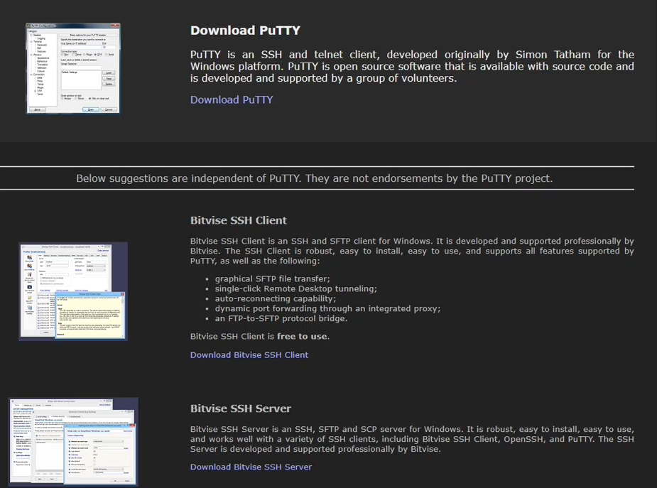

Slide 12
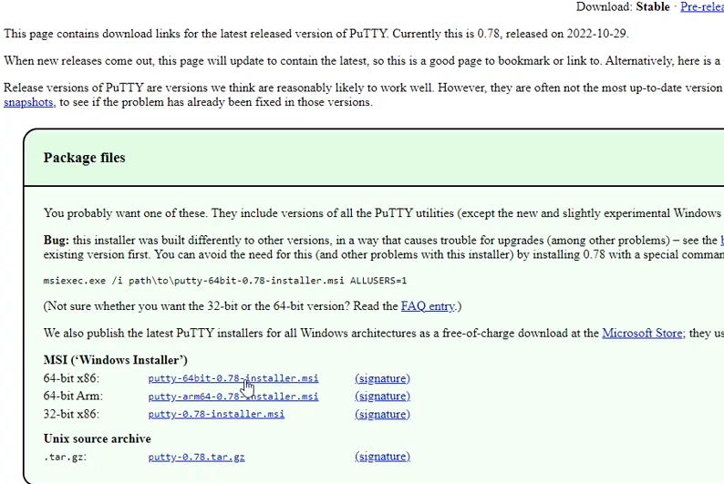

Slide 13
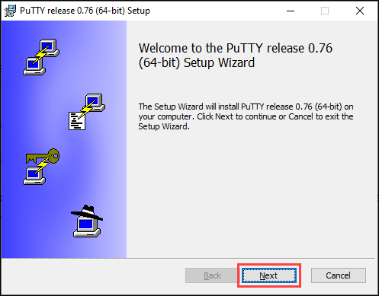
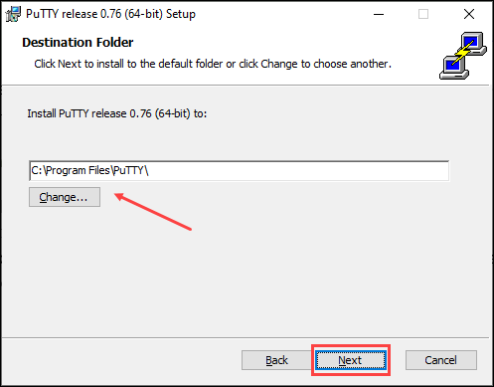

Install Putty

Slide 14
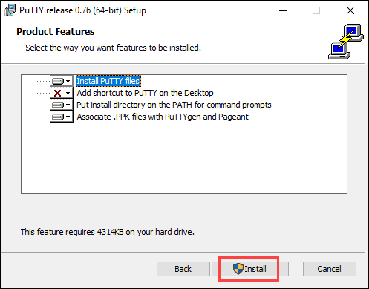
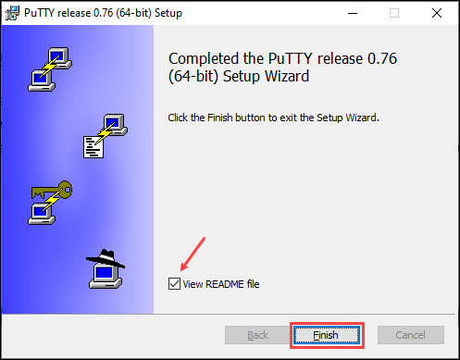
Install Putty

Slide 15
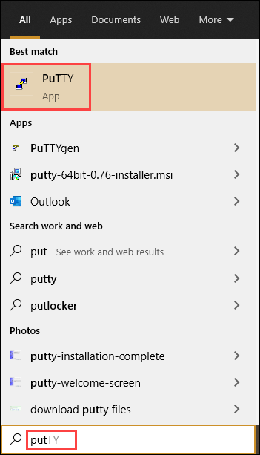
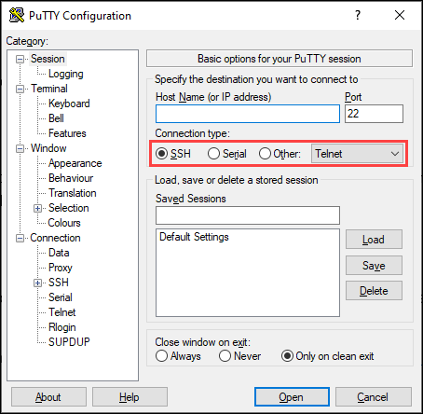
Launch Putty

Slide 16
WinSCP
WinSCP is a popular and free open-source file transfer client.
It allows users to securely transfer files between a local machine and remote servers using a variety of protocols, including Secure Shell (SSH), Secure File Transfer Protocol (SFTP), and FTP over TLS/SSL.
Download and install WinSCP - https://winscp.net/eng/download.php

Slide 17
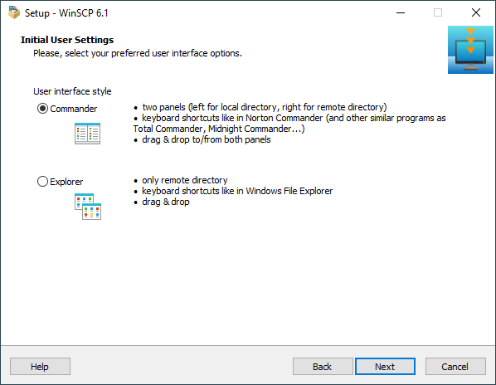
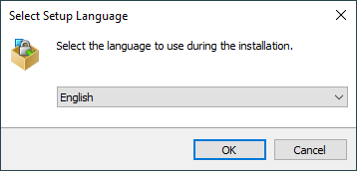
Install WinSCP

Slide 18
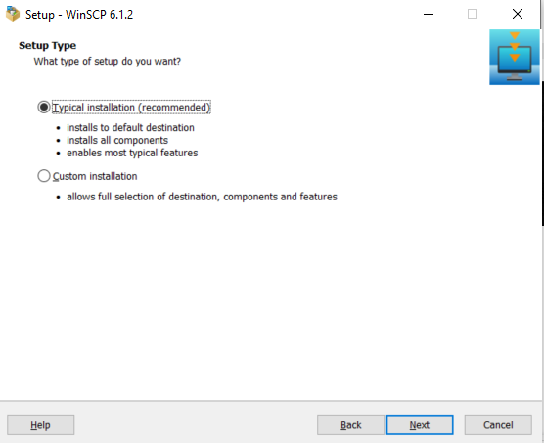

Slide 19
Next set of commands
sudo yum update
sudo yum install python -y
sudo yum install pip
Upload project to EC2 instance using FileZilla
pip3 install –r requirements.txt
If getting following error for above command then use python3 -m pip install -r requirements.txt
Defaulting to user installation because normal site-packages is not writeable
ERROR: Invalid requirement: '–r’

Slide 20
sudo yum update
The command "sudo yum update" is used in Linux-based systems, particularly those that use the Yellowdog Updater, Modified (YUM) package manager, to update the installed software packages to their latest available versions. This command is commonly used on distributions such as CentOS and Red Hat Enterprise Linux (RHEL). Here's what each part of the command does:
sudo: This is a command that allows a user to execute another command with superuser (administrative) privileges. It stands for "Super User Do" and is often used to perform tasks that require elevated permissions.
yum: This is the package manager used in some Linux distributions to manage software installation, updates, and removal. YUM stands for "Yellowdog Updater, Modified."
update: This is a YUM subcommand that instructs the package manager to check for updates to all installed packages and install the latest available versions if updates are found.

Slide 21
Next set of commands
sudo yum update
sudo yum install python -y
sudo yum install pip
Upload project to EC2 instance using WinSCP/FileZilla
pip3 install –r requirements.txt
If getting following error for above command then use python3 -m pip install -r requirements.txt
Defaulting to user installation because normal site-packages is not writeable
ERROR: Invalid requirement: '–r’

Slide 22
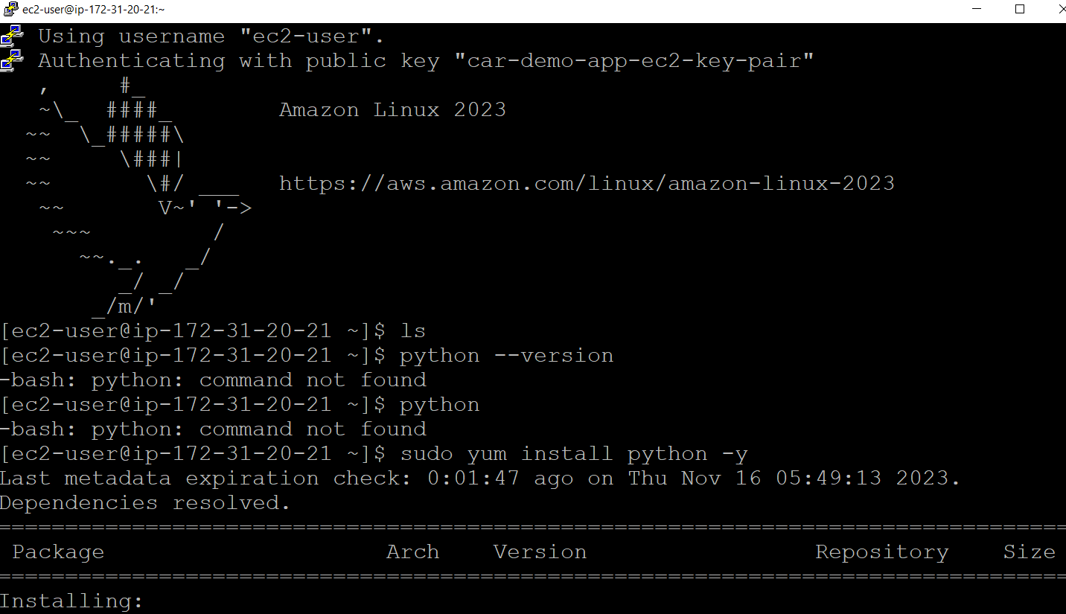

Slide 23
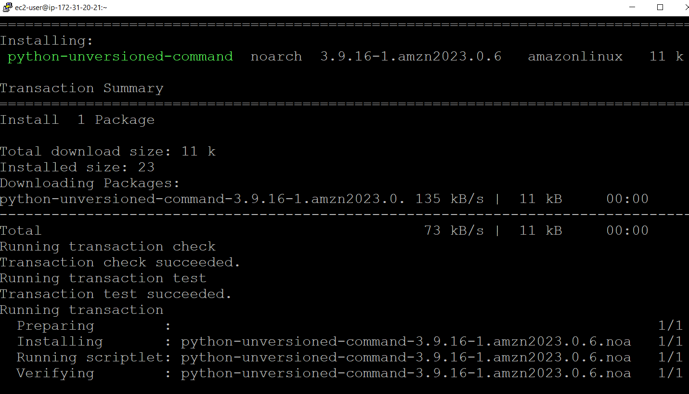

Slide 24
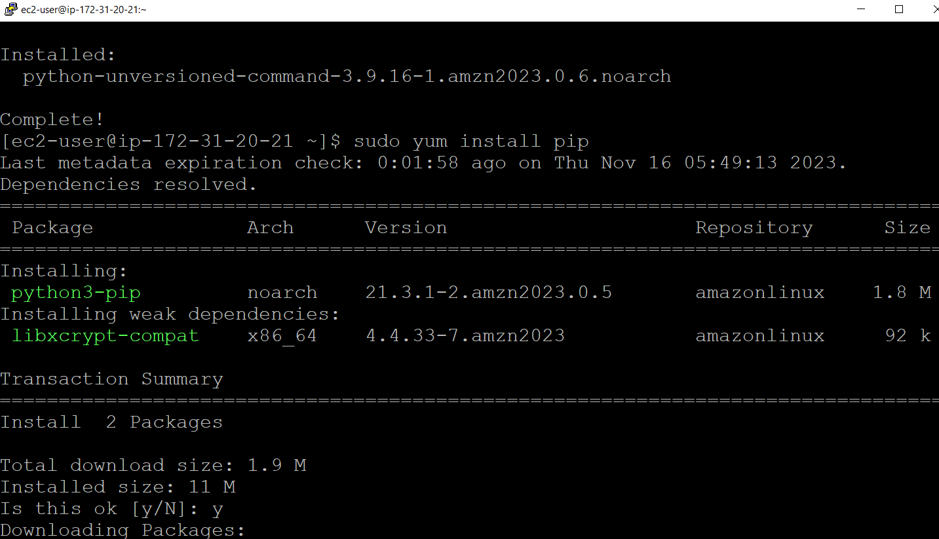

Slide 25
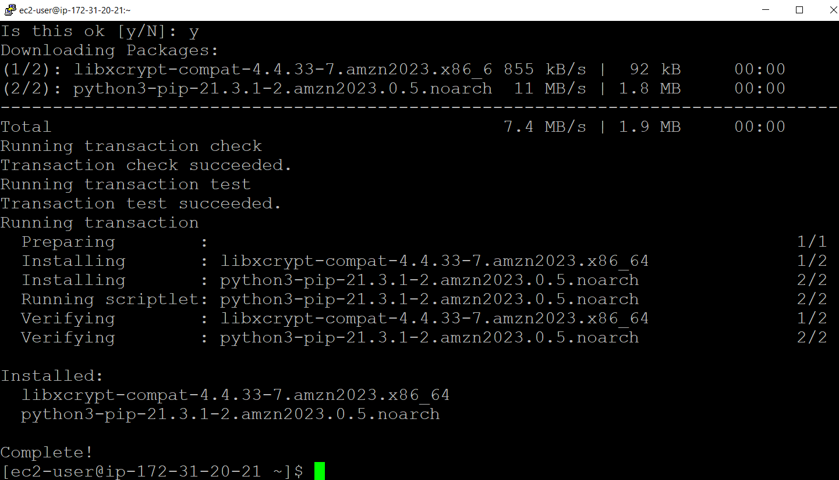

Slide 26
WinSCP
Connect to EC2 using WinSCP
Transfer project code to EC2 instance
Go to project folder using putty
Install requirements.txt

Slide 27
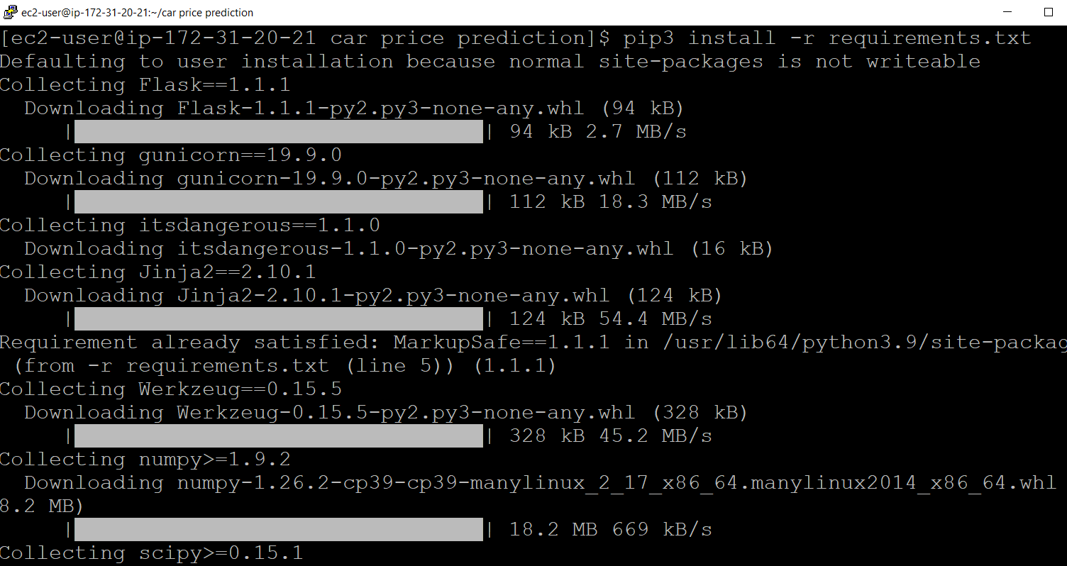

Slide 28
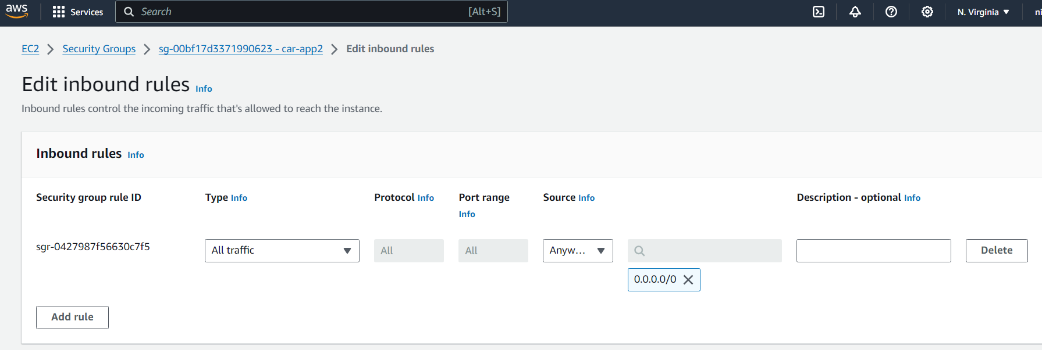

Slide 30
Summary
What is EC2?
Setup EC2
Download install Putty & WinSCP

